Slide 1
Figure 16-1

Slide 2
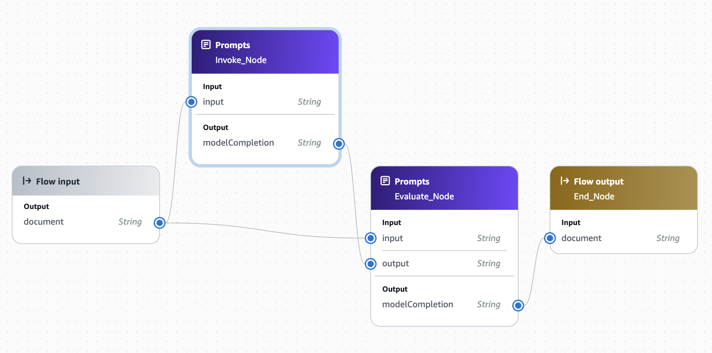
2
1
3
4

